Slide 1

Tesco Operating Model
International Operations Development
Design Group
June 2006
Notes:
1

Slide 2
Introduction
Objectives of the Tesco Operating Model
To represent the business operating processes of the Tesco business
To describe what we do, why we do it and how we measure it
To detail the processes and understand how we operate
Approach to define the Tesco Operating Model – Phase 1
A series of workshops to produce a draft operating model by area of business operation capturing ‘what we do’ (a level 1 process) and ‘how we do it’ ( a level 2 process)
Progress to date
We have completed the draft operating model for the following business areas:
  Space Range and Display, Buy (Commercial), Forecast and Order, Distribution and In-store replenishment, Front-end and Service, and the supporting functional areas of Finance and People.
There is further work underway to complete the Operating processes for
  Marketing, Build, Management Information and IT Services ( We will cover Corporate Purchasing and Joint Buying processes for the model at a later stage)
What’s next?
Review the Tesco Operating model with business experts
Sign-off the Tesco Operating model design
Start work on Phase 2 to detail the next level of business processes

Slide 3
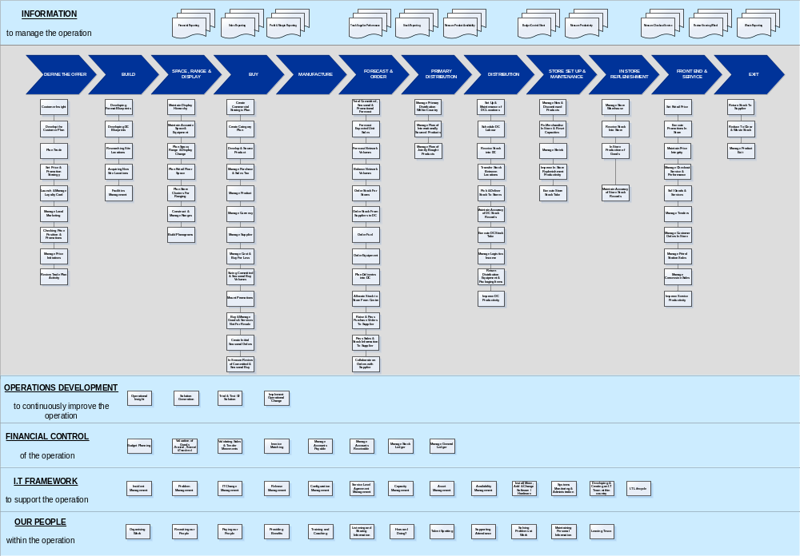
Tesco Operating Model
Draft

Slide 4
Tesco Operating Model
Sample
Forecast and Ordering – Jurrien Heynen
June 2006
Notes:
1

Slide 5
Forecast and Ordering - Executive Summary
Forecast and Ordering covers the following:
  Forecasting of expected sales
  Ordering of stock for stores and Distribution Centres from suppliers
  Planning of volumes in the physical distribution network
The key benefits are that:
  We maximise stock availability for customers
  We waste very little stock in store
  We have the lowest possible level of stock in the store warehouse
  In-store Replenishment costs are minimised
  Processes in the Stores are simple and enable maximum availability of stock at minimum operating costs
Our main dependencies are with:
  Commercial: to provide information on promotions,new product lines, one-off buys ; to maintain logistics data for products
  Space, Range and Display: to provide shelf capacity and ranging information by store,to support stock clearance,
  MIS: to provide actual store sales
  Marketing: to provide the details and dates of promotional events, forecasted sales volumes to allow for volume planning
  New Store Team: to provide locations, dates and sales plans for new stores
  Store Operations: to follow the processes to maintain an accurate stock record
Key decisions to be made include:
  Decide what is best practice for managing stock levels during promotions.
  What is the best way to develop expertise on systems and supply chain optimisation – centrally or locally? - Decision is centrally.
Notes:
2

Slide 6
Forecast and Ordering - Benefits
Forecasting and Ordering –
Having accurate forecasting and ordering is a critical factor in our competitive advantage. A key part of our offer is to ensure that as a customer “I can get what I want” and accurate ordering of stock and replenishment to store shelves at lowest cost and with minimal waste is one of the building blocks of our business model
When we forecast and order what we want accurately, we:
  improve product availability, (.25% increase in sales for every 1% increase in availability)
  reduce levels of aged stock allowing us to sell more stock at full price
  reduce waste, (by as much as 40% compared to when we order manually)
  reduce store warehouse stock, (by as much as 50% to when we order manually allowing us to run with smaller backrooms as a proportion of selling space)
  reduce levels of stock in the supply chain (14 days stock overall in the UK vs. up to 40 days in Central Europe)
  reduce in-store replenishment costs, (by up to 20% by increasing the amount of stock that goes on the shelf first time)
  make it simpler for stores, (by no longer asking stores to calculate and review orders thus reducing staffing levels in stock control)
Forecast and Ordering is the process by which we ensure that our customers can get what they want ; by forecasting sales, ordering the correct levels of stock and moving it efficiently to the shelf to maximise availability at minimum cost

Slide 7
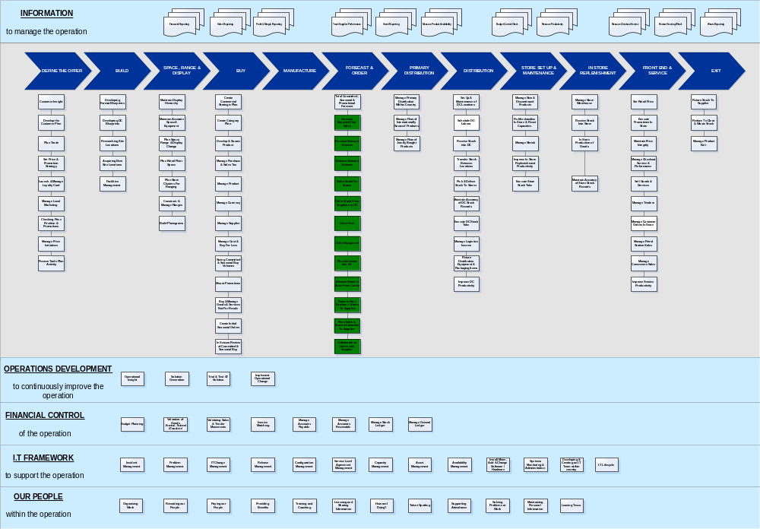
Tesco Operating Model - Forecast and Ordering
Draft

Slide 8
Forecast and Ordering Capability
What we do? | What does this mean? | Why do we do it? | How do we measure it?
Forecast expected unit sales | We forecast what we expect to sell of an item. So that when we order, we know how many we need. | If we forecast correctly what we expect to sell we will not order too much or too little, and therefore maximise availability and minimise stock holding/waste. | The error between what we forecasted to sell in units and what we actually sold in the store expressed as a percentage error. We also measure the accuracy of the store order forecast against the actual order.
Order Stock for Stores | We calculate orders so that customers can get what they want, we fill our shelves cheaper than our competitors by ordering what we need when we need it. | If we order correctly; - customers can always get what they want, our shelf displays are always presentable - our shelves are quick to fill because most of the stock fits on the shelf when the order arrives - we only have what we want in the store warehouse, so we can find what we’re looking for easily | We measure the number of gaps we have on our shelves, how much product we have to reduce or throw away, how much stock we have in our stores and how many days it will last
Order stock for Distribution Centre | We order some lines from suppliers that are stocked in the Distribution Centre and from which stores can order regularly | Store can order more frequently and on a shorter lead times and if we order correctly; - store orders can be met in full - there is always sufficient space in the Distribution Centre when a supplier delivery arrives | We measure whether our suppliers deliver to us on time and in full. Also that we have enough space in the Distribution Centre to store the goods when the delivery arrives.
Ordering too much leads to waste and excess stock in store, ordering too little loses sales and customers

Slide 9
Forecast and Ordering Capability
What we do? | What does this mean? | Why do we do it? | How do we measure it?
Allocate Stock to Stores from Centre | For some products and occasions we centrally push stock to stores rather than waiting for sales to pull stock | For some products and occasions if we wait for sales to pull stock, it can be too late or the stock is not shared correctly across the stores. Examples of products and occasions: - stock is in short supply - there has been a fixed quantity bought - introduction of a new line - display stocks are delivered before a promotion starts - stock is delivered before it is needed to smooth distribution delivery volumes ahead of a busy period - seasonal lines (e.g. clothing, Valentines, Easter, etc.) - etc. | We measure when we allocate an item that the quantities are met in full and are delivered to stores on time.
Raise and Pass Purchase Order to Supplier | We create orders to purchase stock from suppliers which are then passed to suppliers using a convenient transmission method | Suppliers know what to deliver and when and to which location | We measure whether our suppliers deliver to us on time and in full.
When we incorrectly forecast promotional sales volumes we end up with excess stock in store

Slide 10
Forecast and Ordering Capability
What we do? | What does this mean? | Why do we do it? | How do we measure it?
Plan Deliveries into Distribution Centre | We organise the timing of deliveries of ordered stock into the Distribution Centre | So that stock is available for stores when they need it and so that when the goods arrive we have space to store the goods and enough doors and people to receive the goods. | We measure Distribution Centre to store service levels We measure how much stock we have to delay into the Distribution Centre because capacity has been exceeded (called back-scheduling)
Forecast Network Volumes | We forecast the volumes of intake and despatch for the Distribution Centres. | We forecast volumes so that Distribution Centres can plan labour to meet demand at the lowest possible cost. | We measure the accuracy of the forecast by comparing actual to forecast volumes.
Manage Network Volumes | We manage the flow of stock into and out of a Distribution Centre to meet store orders and deliver stock to stores in time. | We smooth the flow of stock from a Distribution Centre to stores to maximise the stock a Distribution Centre can deliver and reduce the cost of handling it. We do this to even out the daily delivery to store profile and to ensure that we have full shelves at the start of the peak trading days in the week. We bring forward store demand where Distribution Centre capacity is exceeded (called Getting Ahead of Trade). | We measure the percentage of goods delivered to stores by day of the week. We measure the level of deliveries received at store on time and the level of Distribution Centre costs.
Pass Sales to supplier | We give information to our suppliers about the sales of their products | When suppliers receive this information they can anticipate and plan their production requirements better ensuring that stock is available to meet demand | We measure Distribution Centre to Store Service Levels
Order Fuel for Petrol Stations | We forecast, order and deliver fuel to the Petrol Filling Stations | Petrol Filling Stations must always have fuel available for our customers to buy as part of the overall Tesco offer | We reconcile daily the amount of fuel held at each PFS
Not forecasting DC volumes accurately results in availability issues or in wasted costs

Slide 11
Forecast and Ordering– Key Dependencies
Level 1 Process | What are we dependant upon | Why is it a dependency? | Who provides us with the information? | Why is the information important to us? What we do with the information?
Forecast Expected Unit Sales | Promotion List | When product is on promotion, what the promotion offer is | Commercial | Calculate Uplift (by product, by Store)
 | New Store Opening Plan | Which Store, and when, customer profile, likely sales by department | New Store Opening Team | Correctly Calculate initial opening weeks sales
 | Event Calendar | What the planned events are and when (e.g. Christmas, Back to School) | Marketing | Apply the sales uplifts at the correct times
 | New Product list/de-list | What new lines are going to be introduced and when, and which stores will stock them | Commercial | So we don't over order or sell out of a new line in the first weeks after launch
 | Product range | What products are stocked by which store | Commercial/Space Range and Display | So we know which store/product combinations require a forecast
 | Corrections to Sales | We need to know how much to adjust actual sales so that we exclude invalid sales (e.g. items sold at reduce price) and items out of stock | Store/Store system | So that the forecast calculation is not corrupted

Slide 12
Forecast and Ordering– Key Dependencies
Level 1 Process | What are we dependant upon | Why is it a dependency? | Who provides us with the information? | Why is the information important to us? What we do with the information?
Order Stock for Stores | Product range | We need to know which products are stocked by which store so that we know which products to create an order for | Commercial/Space Range and Display | So we order the right products for the right stores
 | Product attributes | Need to know product information (e.g.Unit size, min order quantity, code life etc.) | Commercial | If not, we could order in the wrong quantity from the wrong supplier
Order Distribution Centre Stocked Items | Logistics data | Need to know supplier information (e.g. lead time, supplier, min order quantity for supplier, supplier agreements, etc.) | Commercial | So we know who to order from and when
 | Product attributes | Need to know product information (e.g.pallet size, min order quantity,distribution channel etc.) | Commercial | So we know what to order and how

Slide 13
Forecast and Ordering– Key Dependencies
Level 1 Process | What are we dependant upon | Why is it a dependency? | Who provides us with the information? | Why is the information important to us? What we do with the information?
Allocate Stock to Stores from Central | Additional display by store and quantity | We need to build displays at the beginning of a promotion | Commercial/Space Range and Display | Initial promotional allocation is a large volume for DC's to deliver so we need to spread the initial allocation across a few days.
 | New line/Start of season | We need to build displays at the beginning of a new season/line | Commercial/Space Range and Display | We need to get stock in store to launch new lines/season in time and even the flow of stock from Distribution Centre
 | Discontinued/Clearance from Distribution Centre | We need to allocate Distribution Centre stocks of lines to stores when they are discontinued | Commercial/Space Range and Display | So we don't have dead stock in Distribution Centre
 | Products and quantities of one off buys | We need to know the quantity and to what store we should send one off buys | Commercial | So we can send the stock to the stores that can sell it
 | Products and quantities of lines that are in short supply | We need to share stock evenly across stores when it is in short supply | Suppliers/Commercial | So we can maintain availability evenly across stores

Slide 14
Forecast and Ordering– Key Dependencies
Level 1 Process
What are we dependant upon
Why is it a dependency?
Who provides us with the information?
Why is the information important to us? What we do with the information?
Forecast Network Volumes
Forecasted sales volumes by category
We need to know the sales volumes to be able to convert it into volume forecasts
Commercial/Marketing
We need to forecast Distribution Centre volumes in order that the Distribution Centre can plan so that service is maintained at the lowest possible cost
Average case values
We need to know the value by case to convert the sales data into volumes
Finance
We need to forecast Distribution Centre volumes in order that the Distribution Centre can plan so that service is maintained at the lowest possible cost
Logistics data
We need to know the singles per case etc to determine the case volume
Commercial
We need to forecast Distribution Centre volumes in order that the Distribution Centre can plan so that service is maintained at the lowest possible cost
Manage Network Volumes
The Distribution Centre daily capabilities
We need to know how much volume the DC can handle to know how much intervention is required
Distribution
We cannot exceed DC capacities without impacting on the timing of delivery of stock to stores which could result in stock availability issues
The daily volume profile at DC
We need to know the existing profile to see how much volume needs to be smoothed and from which days
Distribution
When we know the current profile we can move volume to different days of the week to reduce Dc costs and to ensure that store shelves are full ahead of the peak trading times of the week

Slide 15
Forecast and Ordering– Key Dependencies
Level 1 Process
What are we dependant upon
Why is it a dependency?
Who provides us with the information?
Why is the information important to us? What we do with the information?
Order Fuel for Petrol Stations
Collection and volume information for fuel to be collected
We need to know where to collect the fuel from and in what quantities to organise the vehicle fleet
Fuel Commercial
The vehicles to collect the fuel from the terminals and deliver to the Petrol Filling stations are organised using this information

Slide 16
Appendix 1
Capability

Slide 17
Forecast and Ordering Capability
What we do? | How we do it | KPI
Forecast expected unit sales | Manage Promotion forecasting Manage Holiday/Event forecasting Manage event planner Manage Unusable Sales Manage Impact of Weather on Forecast Manage New item forecasting Manage New store forecasting Manage Alternate Item Hierarchy Manage Alternate Store hierarchy Manage Forecast Exports (Supplier/DC) Setup initial configuration/system Optimise Forecasting System settings Maintain forecasting system daily | The error between what we forecasted to sell and what we actually sold expressed as a percentage error.
Order Stock for Stores | Calculate, review and amend order Setup initial configuration/setup Maintain store ordering system daily Maintain Central System settings | We measure the number of gaps we have on our shelves, how much product we have to reduce or throw away, how much stock we have in our stores and how many days it will last
Order stock for Distribution Centre | Calculate, review and amend Distribution Centre Order Maintain Distribution Centre Order Schedule Order In stock as an Investment Buy Create Initial Order for New Distribution Centre Setup initial system/configuration | We measure whether our suppliers deliver to us on time and in full. Also that we have enough space in the Distribution Centre to store the goods when the delivery arrives.
Allocate Stock to Stores from Centre | Request Allocation Define Exit Plan Determine Allocation type required Produce and review suggested allocation Approve Allocation Order pending allocation stock into Distribution Centre Confirm Allocation Actioned Incorporate Allocations into Forecast and Ordering | We measure when we allocate an item that the quantities are met in full and are delivered to stores on time.

Slide 18
Forecast and Ordering Capability
What we do? | How we do it | How do we measure it?
Raise and Pass Purchase Order to Supplier | Setup and use Purchase Order Approval Method Raise and Approve Purchase Order Order Passing Cross Dock and Pick by Line Order Consolidation | We measure whether our suppliers deliver to us on time and in full.
Plan Deliveries into Distribution Centre | Manage Warehouse Inbound Planning Maintain supplier delivery schedule into Distribution Centre We calculate forward stock levels in the Distribution Centre | We measure Distribution Centre to store service levels We measure how much stock we have to delay into Distribution Centre because capacity has been exceeded (called back-scheduling)
Forecast Network Volumes | Forecast Distribution Centre Inbound and Outbound volumes by case and by pallet | We measure the accuracy of the forecasts against the actual volumes
Manage Network Volumes | Smooth Distribution Centre to store peaks and troughs in volume Smooth Distribution Centre daily volume profile | We measure the percentage of goods delivered to stores by day of the week. We measure the level of deliveries received at store on time and the level of Distribution Centre costs
Pass Sales to suppliers | Provide information to our suppliers about the sales levels of their products in our stores | We measure Distribution Centre to store service levels
Order Fuel for Petrol Stations | Forecast level of Fuel sales Reconcile actual stock levels Create fuel orders | Actual stock levels versus expected stock levels

Slide 19
Appendix 2
Interdependencies

Slide 20
Forecast and Ordering Interdependencies
What we do | How do we do it (level 2 process) | Why is it a dependency?
Forecast Expected unit Sales | Manage Promotion forecasting Manage Holiday/Event forecasting Manage event planner Manage Unusable Sales Manage Impact of Weather on Forecast Manage New item forecasting Manage New store forecasting Manage Alternate Item Hierarchy Manage Alternate Store hierarchy Manage Forecast Exports (Supplier/DC) Setup initial configuration/system Optimise Forecasting System settings Maintain forecasting system daily | When product is on promotion, what the promotion offer is
 |  | Which Store, and when, customer profile, likely sales by department
 |  | What the planned events are and when (e.g. Christmas, Back to School)
 |  | What new lines are going to be introduced and when, and which stores will stock them
 |  | What products are stocked by which store
 |  | We need to know by what, to adjust actual sales so that we exclude invalid sales (e.g. items sold at reduce price, and items out of stock)
 |  | Automatically generate a forecast
 |  | Historic pre-processed sales by product, by store
 |  | Weather forecast at least 4 days in advance

Slide 21
Forecast and Ordering Interdependencies
What we do | How do we do it (level 2 process) | Why is it a dependency?
Order Stock for Stores | Calculate, review and amend order Setup initial configuration/setup Maintain store ordering system daily Maintain Central System settings | We need to know which products are stocked by which store so that we know which products to create an order for
 |  | Need to know product information (e.g.Unit size, min order quantity, code life etc.)
 |  | Need to know supplier information (e.g. lead time, supplier, min order quantity for supplier, supplier agreements, etc.)
 |  | Product in store information to place the order (e.g. shelf capacity, stock on hand, actual sales, customer orders etc.)
 |  | We need to know the range, shelf capacities for the new store and when store opens
 |  | We need to know what we expect to sell when calculating an order
 |  | From the peak trading capacity plan we need to know how much stock needs to be delivered before the peak week.
Order stock for Distribution Centre | Calculate, review and amend Distribution Centre Order Maintain Distribution Centre Order Schedule Order In stock as an Investment Buy Create Initial Order for New Distribution Centre Setup initial system/configuration | We need to know which products to order into Distribution Centre stock
 |  | Need to know supplier information (e.g. lead time, supplier, min order quantity for supplier, supplier agreements, etc.)
 |  | Need to know product information (e.g.pallet size, min order quantity,distribution channel etc.)
 |  | We need to know aggregated store expected sales in singles
 |  | From the peak trading capacity plan we need to know how much stock needs to be delivered into the Distribution Centre before the peak week.

Slide 22
Forecast and Ordering Interdependencies
What we do | How do we do it (level 2 process) | Why is it a dependency?
Allocate Stock to Stores from Central | Request Allocation Define Exit Plan Determine Allocation type required Produce and review suggested allocation Approve Allocation Order pending allocation stock into Distribution Centre Confirm Allocation Actioned Incorporate Allocations into Forecast and Ordering | We need to allocate stock early to reduce peak period delivery to store quantities
 |  | We need to build displays at the beginning of a promotion
 |  | We need to build displays at the beginning of a new season/line
 |  | We need to allocate Distribution Centre stocks of lines to stores when they are discontinued
 |  | We need to know the quantity and to what store we should send one off buys
 |  | We need to share stock evenly across stores when it is in short supply

Slide 23
Forecast and Ordering Interdependencies
What we do | How do we do it (level 2 process) | Why is it a dependency?
Raise and Pass Purchase Order to Supplier | Setup and use Purchase Order Approval Method Raise and Approve Purchase Order Order Passing Cross Dock and Pick by Line Order Consolidation | We need a simple and accurate method of passing purchase orders to suppliers
Plan Deliveries into Distribution Centre | Manage Warehouse Inbound Planning | We need to know what is coming into the Distribution Centre and when
 |  | We need to know how much stock/vehicles the Distribution Centre can receive by day
Forecast Network Volumes Manage Network Volumes | Forecast Distribution Centre Inbound and Outbound volumes Smooth Distribution Centre to store peaks and troughs in volume Smooth Distribution Centre daily volume profile | We need to know the sales volumes to be able to convert it into volume forecasts
 |  | We need to know the value by case to convert the sales data into volumes
 |  | We need to know the singles per case etc to determine the case volume
 |  | We need to know which products are centralised to calculate the forecasted Distribution Centre volumes
 |  | We need to know where the Distribution Centre volumes are high or low against the average level
 |  | We need to know what the actual profile is in order to see if it is uneven
Pass Sales to Supplier | Identify sales by supplier Pass sales and sku data via suitable data network | We want to share information with our suppliers in order that they can plan production better to meet our ordering requirements
Order Fuel for Petrol Stations | Forecast level of Fuel sales Reconcile actual stock levels Create fuel orders Collect fuel from terminals Deliver fuel to Petrol Stations | We need to know the collection points and volumes for fuel

